Slide 1

Jenkins Continuous Build System

Slide 2
summary
Continuous integration systems are a vital part of any Agile team because they help enforce the ideals of Agile development
Jenkins, a continuous build tool, enables teams to focus on their work by automating the build, artifact management, and deployment processes
Jenkins’ core functionality and flexibility allow it to fit in a variety of environments and can help streamline the development process for all stakeholders involved

Slide 3
CI - Defined
“Continuous Integration is a software development practice where members of a team integrate their work frequently, usually each person integrates at least daily - leading to multiple integrations per day. Each integration is verified by an automated build (including test) to detect integration errors as quickly as possible” – Martin Fowler

Slide 4
CI – What does it really mean?
At a regular frequency (ideally at every commit), the system is:
Integrated
All changes up until that point are combined into the project
Built
The code is compiled into an executable or package
Tested
Automated test suites are run
Archived
Versioned and stored so it can be distributed as is, if desired
Deployed
Loaded onto a system where the developers can interact with it

Slide 5

CI - Workflow
Regular Interval
Continuous Build System
Artifact Repository
Code Repository
Executable/ Package
Testing Results
Source & Tests
Test Reports
Deployment
Developers

Slide 6
CI – Benefits
Immediate bug detection
No integration step in the lifecycle
A deployable system at any given point
Record of evolution of the project

Slide 7
CI – The tools
Code Repositories
SVN, Mercurial, Git
Continuous Build Systems
Jenkins, Bamboo, Cruise Control
Test Frameworks
JUnit,Cucumber, CppUnit
Artifact Repositories
Nexus, Artifactory, Archiva

Slide 8

Jenkins
Branched from Hudson
Java based Continuous Build System
Runs in servlet container
Glassfish, Tomcat
Supported by over 400 plugins
SCM, Testing, Notifications, Reporting, Artifact Saving,Triggers, External Integration
Under development since 2005
http://jenkins-ci.org/

Slide 9
Jenkins - History
2005 - Hudson was first release by Kohsuke Kawaguchi of Sun Microsystems
2010 – Oracle bought Sun Microsystems
Due to a naming dispute, Hudson was renamed to Jenkins
Oracle continued development of Hudson (as a branch of the original)

Slide 10
Jenkins – Fitting in
Code Repository
Regular Interval
Executable/ Package
Artifact Repository
Testing Results
Source & Tests
Test Reports
Deployment
Developers

Slide 11
Why Jenkins? Flexibility!
Jenkins is a highly configurable system by itself
The additional community developed plugins provide even more flexibility
By combining Jenkins with Ant, Gradle, or other Build Automation tools, the possibilities are limitless

Slide 12
Why Jenkins? Free/OSS
Jenkins is released under the MIT License
There is a large support community and thorough documentation
It’s easy to write plugins
Think something is wrong with it? You can fix it!

Slide 13
What can Jenkins do?
Generate test reports
Integrate with many different Version Control Systems
Push to various artifact repositories
Deploys directly to production or test environments
Notify stakeholders of build status
…and much more

Slide 14
Jenkins
In Jenkins, a pipeline is a group of events or jobs which are interlinked with one another in a sequence.
In simple words, Jenkins Pipeline is a combination of plugins that support the integration and implementation of continuous delivery
pipelines using Jenkins.
A pipeline has an extensible automation server for creating simple or complex delivery pipelines "as code," via pipeline DSL.

Slide 15
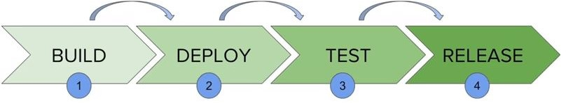
Jenkins Pipeline

Slide 16
Layout
Every state has its events, which work in a sequence called a continuous delivery pipeline.
A continuous delivery pipeline is an automated expression to display your process for getting software for version control. Thus, every change made in your software goes through a number of complex processes on its way to being released.
It also involves developing the software in a reliable and repeatable manner, and progression of the built software through multiple stages of testing and deployment.

Slide 17
Jenkins pipelines can be defined using a text file called JenkinsFile.
You can implement pipeline as code using JenkinsFile, and this can be defined by using a domain specific language (DSL).
With JenkinsFile, you can write the steps needed for running a Jenkins pipeline.

Slide 18
JenkinsFile
The benefits of using JenkinsFile are:
You can create pipelines automatically for all branches and execute pull requests with just one JenkinsFile.
You can review your code on the pipeline
You can audit your Jenkins pipeline
This is the singular source for your pipeline and can be modified by multiple users.
JenkinsFile can be defined by either Web UI or with a JenkinsFile.

Slide 19
Create multiple automation jobs with the help of use cases, and run them as a Jenkins pipeline.
Here are the reasons why you use should use
Jenkins pipeline is implemented as a code which allows multiple users to edit and execute the pipeline process.
Pipelines are robust. So if your server undergoes an unforeseen restart, the pipeline will be automatically resumed.
You can pause the pipeline process and make it wait to resume until there is an input from the user.
Jenkins Pipelines support big projects. You can run multiple jobs, and even use pipelines in a loop.

Slide 20
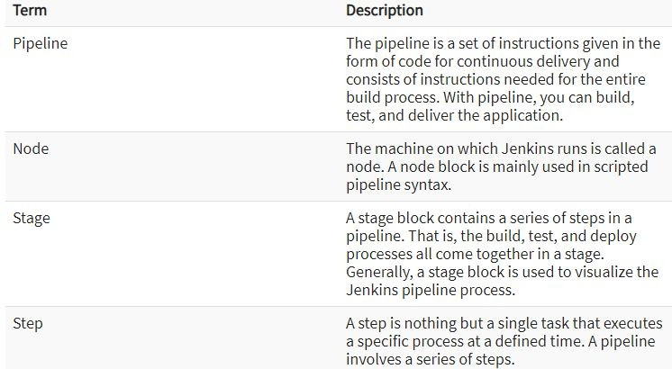

Slide 21
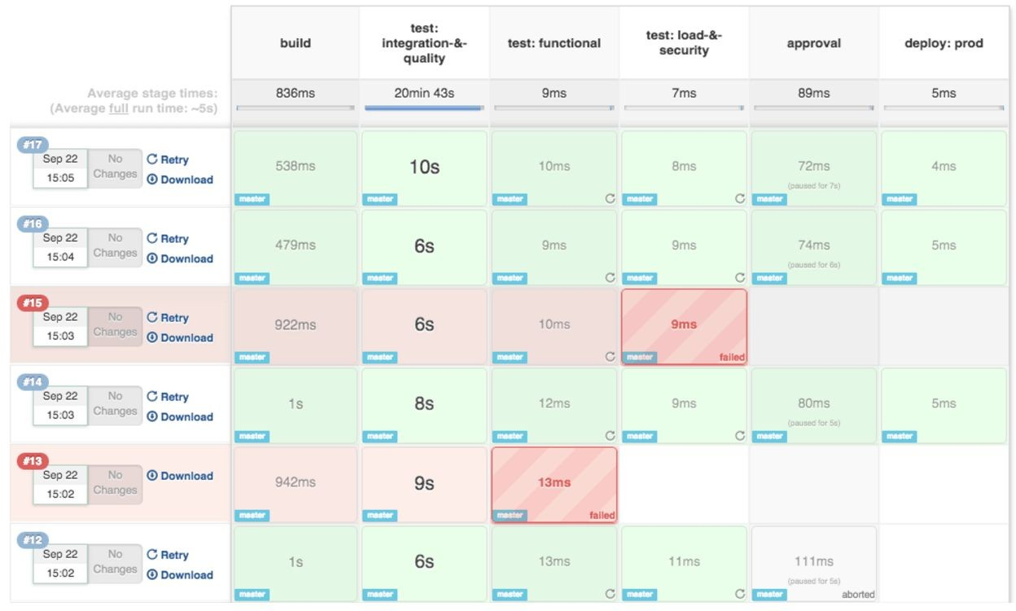

Slide 22
Jenkins is an awesome Continuous Integration tool which allows you to add multiple slaves as per your project requirement to a central Master server.
In distributed environment, we need different machines for different purposes. For example, we may need machine1(Ubuntu) to run some process and machine2(CentOS) to run some other process.
For such distribution, Jenkins Master Slave configuration comes to the rescue.

Slide 23
How Jenkins works - Setup
When setting up a project in Jenkins, out of the box you have the following general options:
Associating with a version control server
Triggering builds
Polling, Periodic, Building based on other projects
Execution of shell scripts, bash scripts, Ant targets, and Maven targets
Artifact archival
Publish JUnit test results and Javadocs
Email notifications
As stated earlier, plugins expand the functionality even further

Slide 24
How Jenkins works - Building
Once a project is successfully created in Jenkins, all future builds are automatic
Building
Jenkins executes the build in an executer
By default, Jenkins gives one executer per core on the build server
Jenkins also has the concept of slave build servers
Useful for building on different architectures
Distribution of load

Slide 25
How Jenkins works - Reporting
Jenkins comes with basic reporting features
Keeping track of build status
Last success and failure
“Weather” – Build trend
These can be greatly enhanced with the use of pre-build plugins
Unit test coverage
Test result trending
Findbugs, Checkstyle, PMD

Slide 26
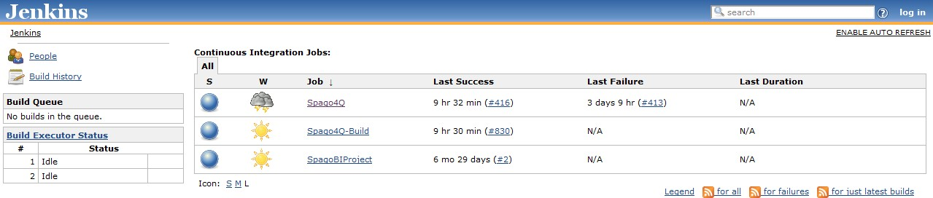
Jenkins by example – Main Page
The main page provides a summary of the projects
Quick view of
What’s building (“No builds in the queue”)
Build Executor Status (both “Idle”)
Status of the projects

Slide 27
Jenkins by example – Project Status
Project status pages provide more details about a given project
The status of the last several builds
Charting (depending on plugins)
Dependencies

Slide 28
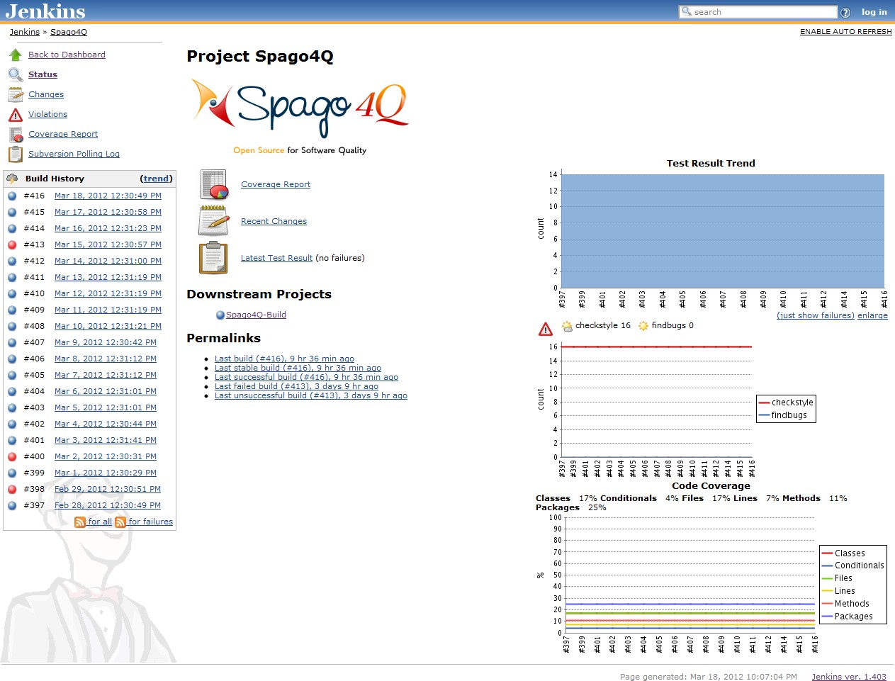
Jenkins by example – Project Status

Slide 29
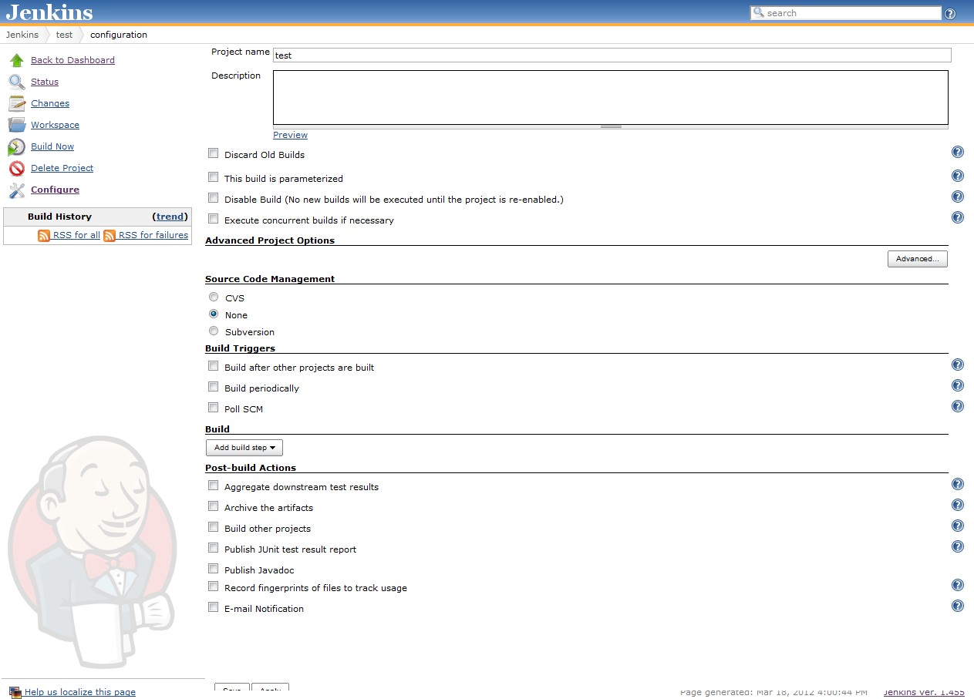
Jenkins by example – New Project

Slide 30
Enhancing Jenkins
Jenkins plugin system can enable a wide range of features including (but certainly not limited to)
SCM
Mercurial, Git, Subversion
Testing
Selenium,Windmill,TestLink
Notifications
IRC,Twitter, Jabber
Reporting
Doxygen, PMD, Findbugs
Artifact Saving
Artifactory, Amazon S3, SCP
Triggers
Jabber, Directory Watchers
External Integration
GitHub, Bugzilla, JIRA
And most importantly – The CI Game
A points based game where developers compete against each other to develop the most stable, well- tested code

Slide 31
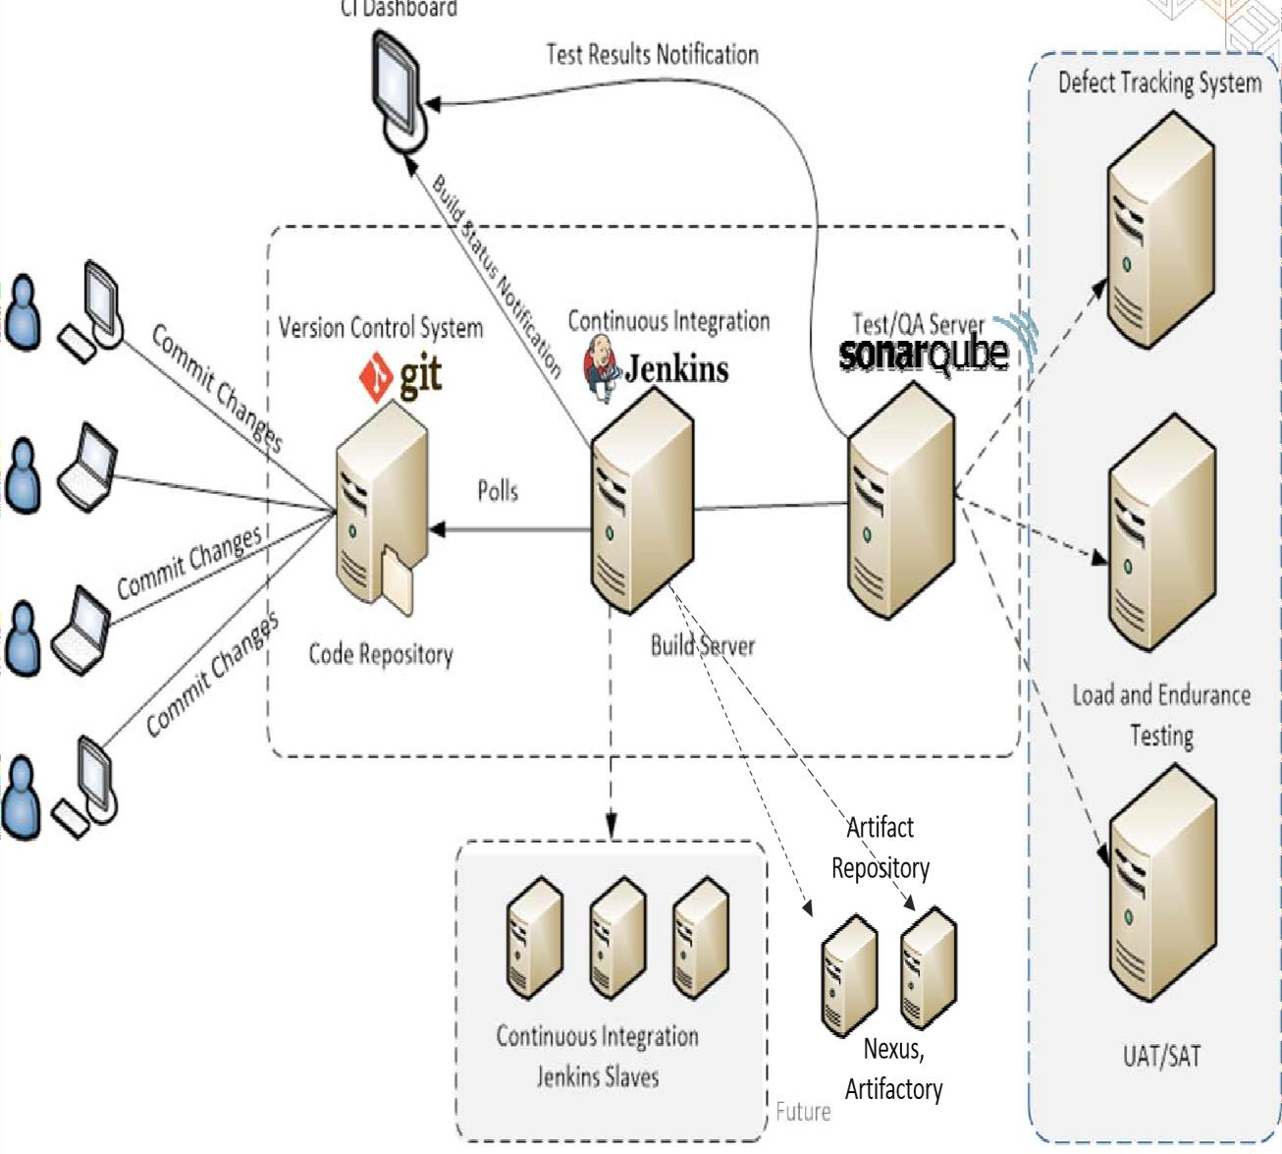
CI/CD Environment

Slide 32
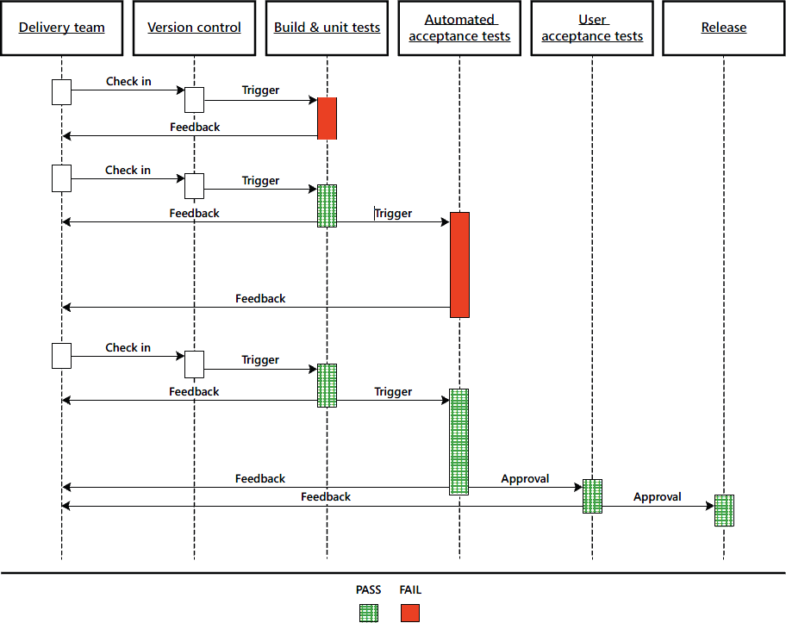

Slide 33
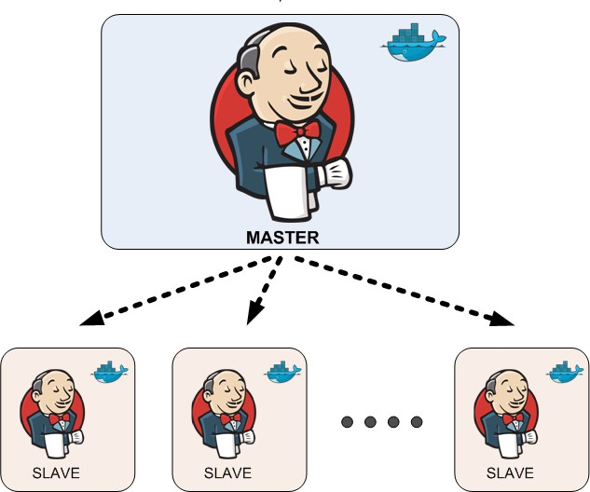
Jenkins’ Master and Slave Architecture
Master:
Schedule build jobs.
Dispatch builds to the slaves for the actual job execution.
Monitor the slaves and record the build results.
Can also execute build jobs directly.
Slave:
Execute build jobs dispatched by the master.

Slide 34
Conclusion
Continuous integration is a necessity on complex projects due to the benefits it provides regarding early detection of problems
A good continuous build system should be flexible enough to fit into pre-existing development environments and provide all the features a team expects from such a system
Jenkins, a continuous build system, can be an integral part of any continuous integration system due to it’s core feature set and extensibility through a plugin system

